Slide 1
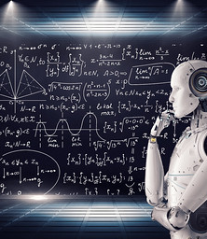
Deep Learning with Python Transformers
Edgar Lobaton, Ph.D.
Electrical & Computer Engr. Dept.
North Carolina State University

Slide 2
Transformers - Motivation
CNNs and RNNs allow for the integration of information on a neighborhood but they are limited on the support of their context. Even LSTMs are not good at finding relationships that are far away.
Training in RNNs is sequential and prone to vanishing gradients.
Attention is a mechanisms that has been used to improve performance in RNNs.
Transformers make use of self-attention to encode the represent of their input while capturing the long-range relations.
This framework was original applied to NLP.

Slide 3
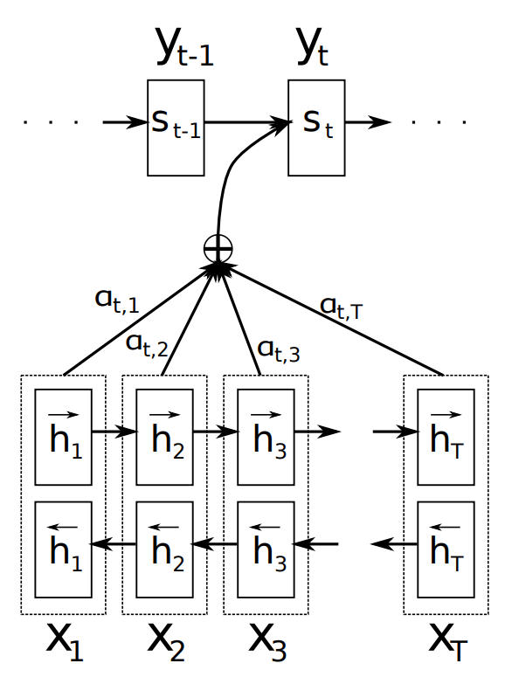
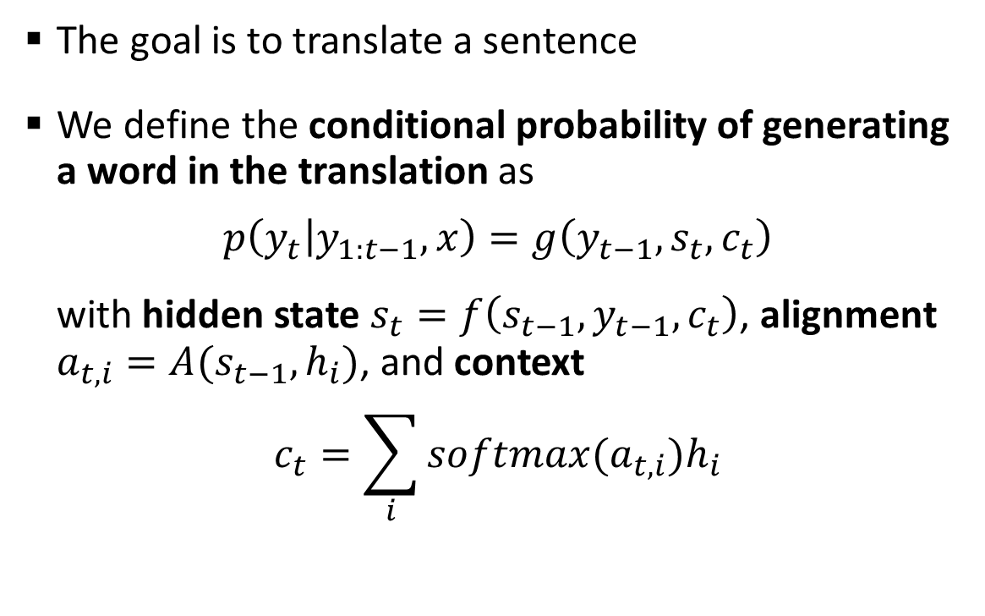
An Example of Global Attention*
The goal is to translate a sentence
We define the conditional probability of generating a word in the translation as
$$p\left(y_{t} | y_{1:t−1},x\right)=g\left(y_{t−1},s_{t}, c_{t}\right)$$
with hidden state $s_{t}=f\left(s_{t−1},y_{t−1},c_{t}\right)$, alignment $a_{t,i}=A(s_{t−1},h_{i})$, and context
$$c_{t}=\sum_{i}{softmax(a_{t,i})h_{i}}$$
*D. Bahdanau et al, "Neural Machine Translation by Jointly Learning to Align and Translate," ICLR 2015.

Slide 4
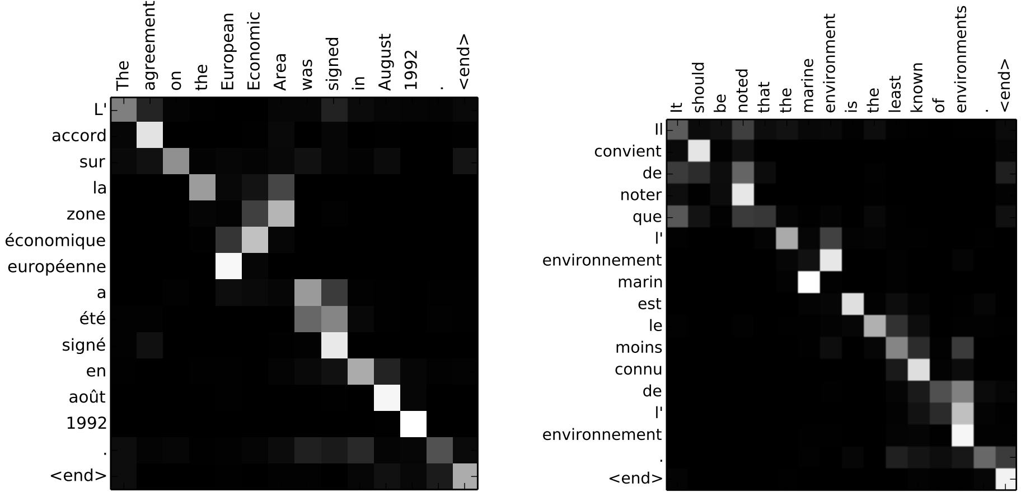
An Example of Global Attention: EN-FR
Examples of Normalized alignments between input (x-axis) and generated sentences

Slide 5
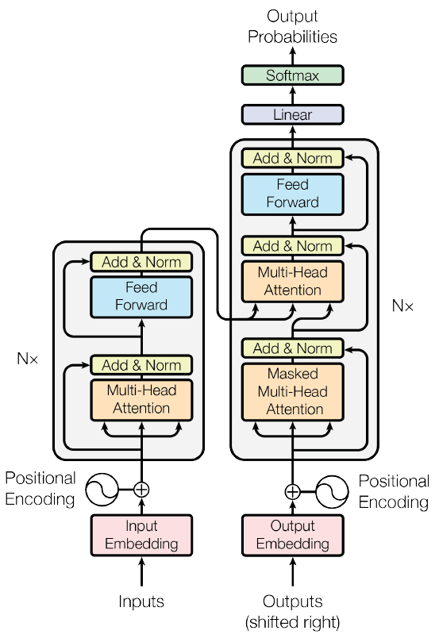
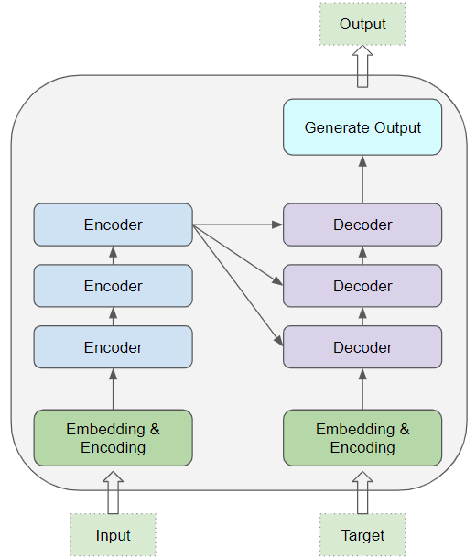
Transformers – Model*
Consists of an encoding / decoding architecture
*A. Vaswani et al, “Attention is All You Need”, 2017

Slide 6
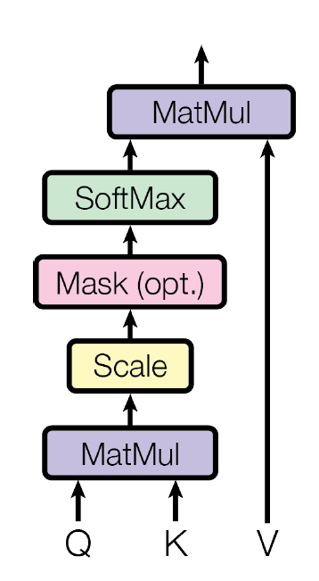
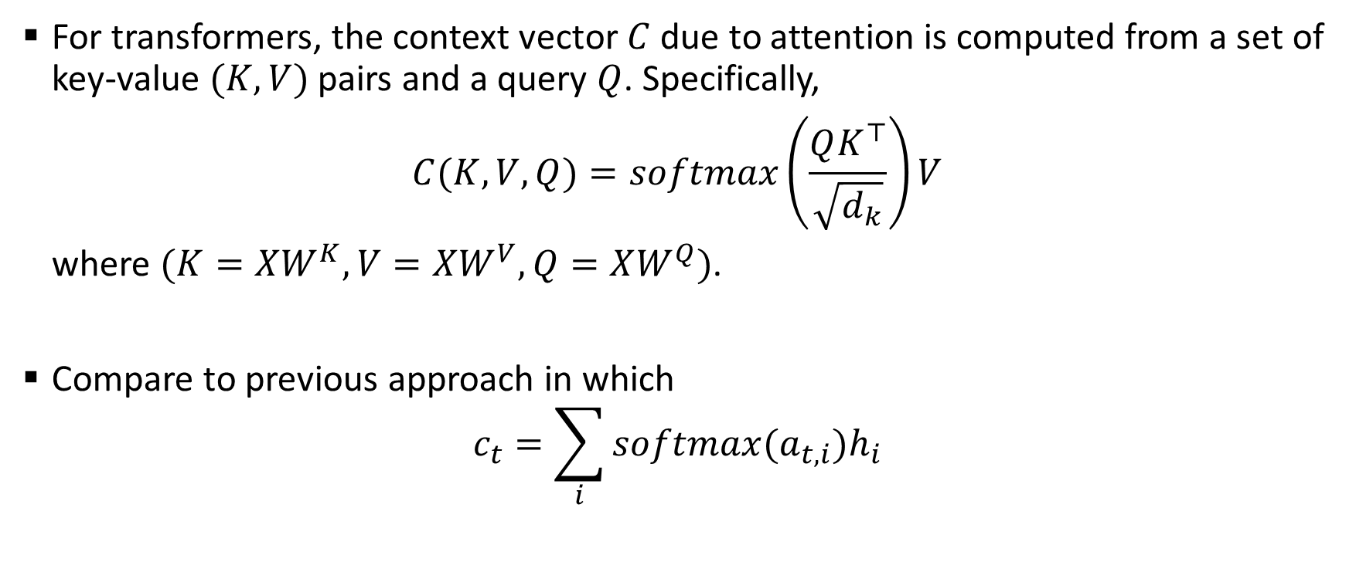
Transformers – Attention
For transformers, the context vector $C$ due to attention is computed from a set of key-value $(K,V)$ pairs and a query $Q$. Specifically,
$$C(K,V,Q)=softmax\left(\frac{QK^{⊤}}{\sqrt{d_{k}}}\right)V$$
where $(K=XW^{K},V=XW^{V},Q=XW^{Q})$.
Compare to previous approach in which
$$c_{t}=\sum_{i}{softmax(a_{t,i})h_{i}}$$

Slide 7
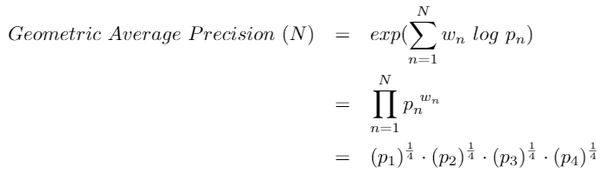
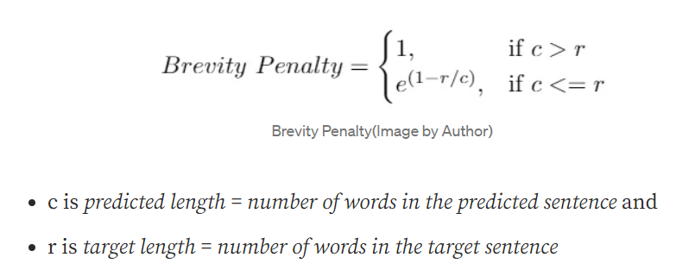
Bleu (Bilingual Evaluation Understudy) Score
It is a weighted version of the geometric average of n-grams:
where

Slide 8
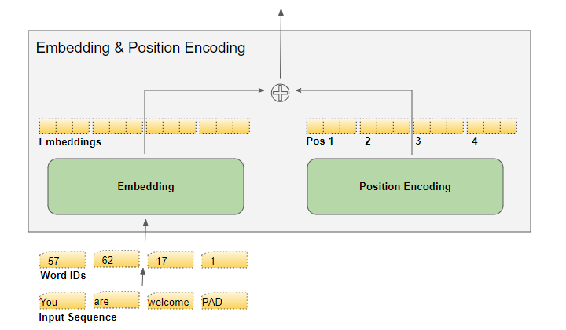
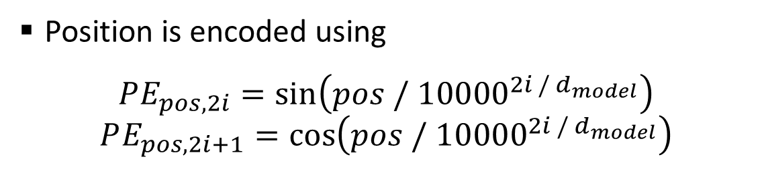
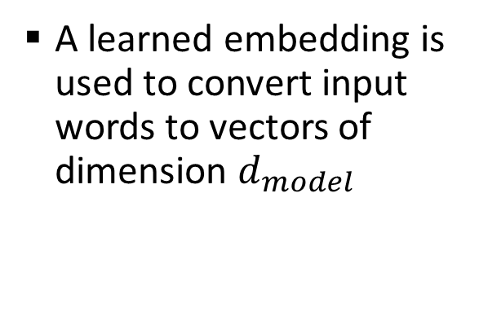
Transformers – Encoding
A learned embedding is used to convert input words to vectors of dimension $d_{model}$
Position is encoded using
$$PE_{pos,2i}=\sin\left(pos / {10000}^{2i / d_{model}}\right)$$
$$PE_{pos,2i+1}=\cos\left(pos / {10000}^{2i / d_{model}}\right)$$

Slide 9
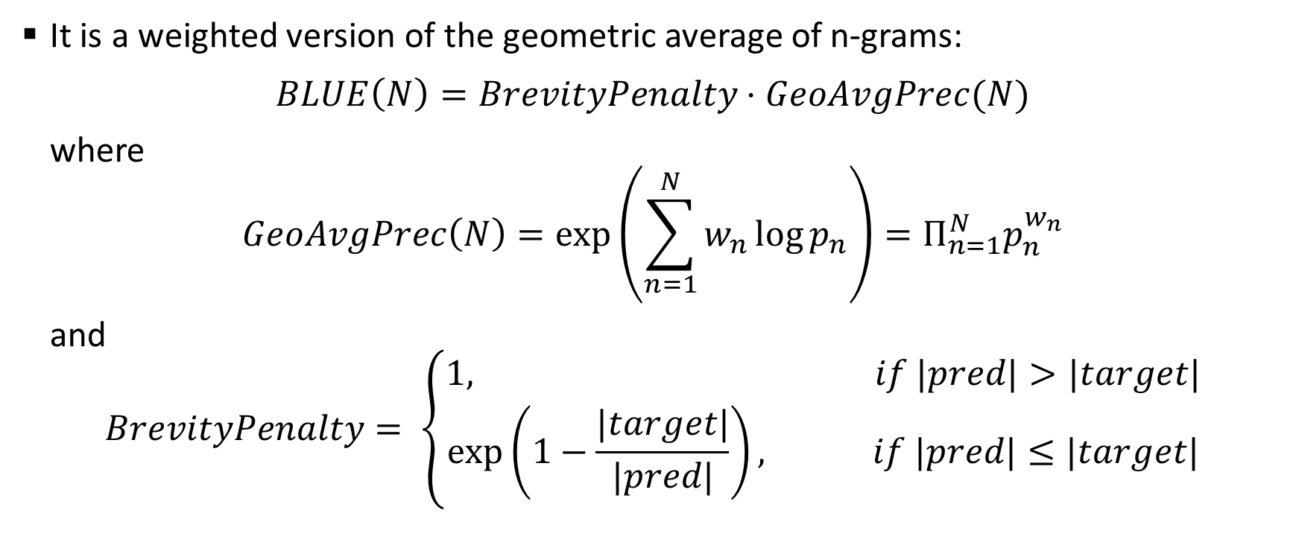
BLEU (BiLingual Evaluation Understudy) Score*
It is a weighted version of the geometric average of n-grams:
$$BLUE\left(N\right)=BrevityPenalty⋅GeoAvgPrec(N)$$
where
$$GeoAvgPrec\left(N\right)=\exp\left(\sum_{n=1}^{N}{w_{n}\log{p_{n}}}\right)=Π_{n=1}^{N}p_{n}^{w_{n}}$$
and
$$BrevityPenalty= \left\{\begin{aligned}1, if |pred|>|target| \\ \exp\left(1−\frac{|target|}{|pred|}\right), if |pred|≤|target|\end{aligned}\right.$$
* https://towardsdatascience.com/foundations-of-nlp-explained-bleu-score-and-wer-metrics-1a5ba06d812b

Slide 10


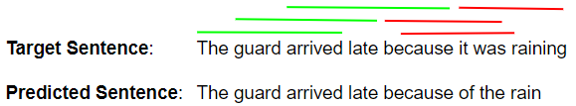
Bleu (Bilingual Evaluation Understudy) Score
The precisions are obtained for each N-gram:
1-Gram Precision
2-Gram Precision
3-Gram Precision

Slide 11
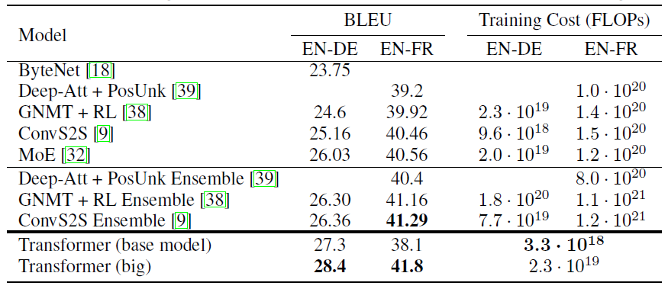
Transformers – NLP Results
“The Transformer achieves better BLEU scores than previous state-of-the-art models on the English-to-German and English-to-French newstest2014 tests at a fraction of the training cost”

Slide 12
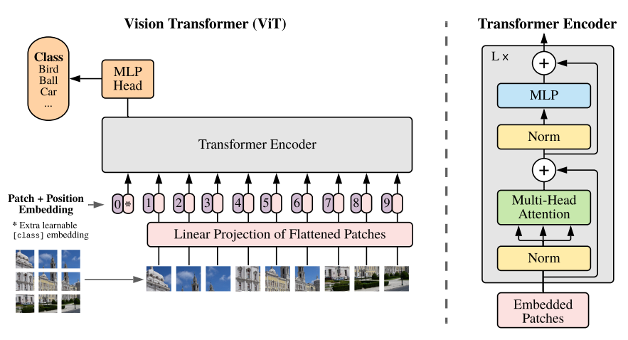
Transformers – Computer Vision*
16 x 16 patches are used instead of words
A position embedding is also performed
Only an encoder architecture is used
* A. Dosovitskiy et al, “An Image is Worth 16x16 Words: Transformers for Image Recognition at Scale”, 2021

Slide 13
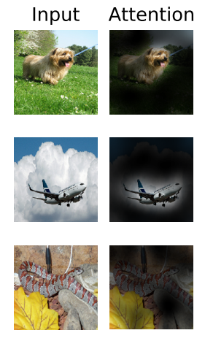
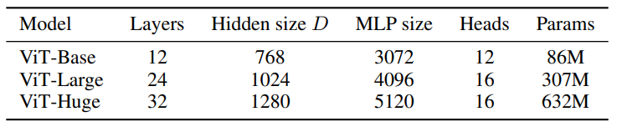
Transformers – Computer Vision
Compared models against ResNet152 (60 million parameters):
Accuracy of network on ImageNet is 88.55% compared to ResNet152 at 87.54%.

Slide 14




Thank you
Edgar Lobaton
edgar.lobaton@ncsu.edu
https://research.ece.ncsu.edu/aros/

